Slide 1
E-COMMERCE APPLICATION ON CLOUD FOUNDRYAPPLICATION ON CLOUD FOUNDRY

Slide 2
USER AUTHENDICATION
User Interface (UI) Design: Design the login form with a clean and intuitive user interface. Keep it simple, with fields for username/email and password, along with clear labels and instructions.
Validation: Implement client-side validation for the login form to ensure that users enter correct and properly formatted information. Also, perform server-side validation to double-check the data and prevent malicious attempts.
Forgot Password: Include a "Forgot Password" link that enables users to reset their password if they forget it. This process should be secure and may involve sending a reset link to the user's registered email address.

Slide 3
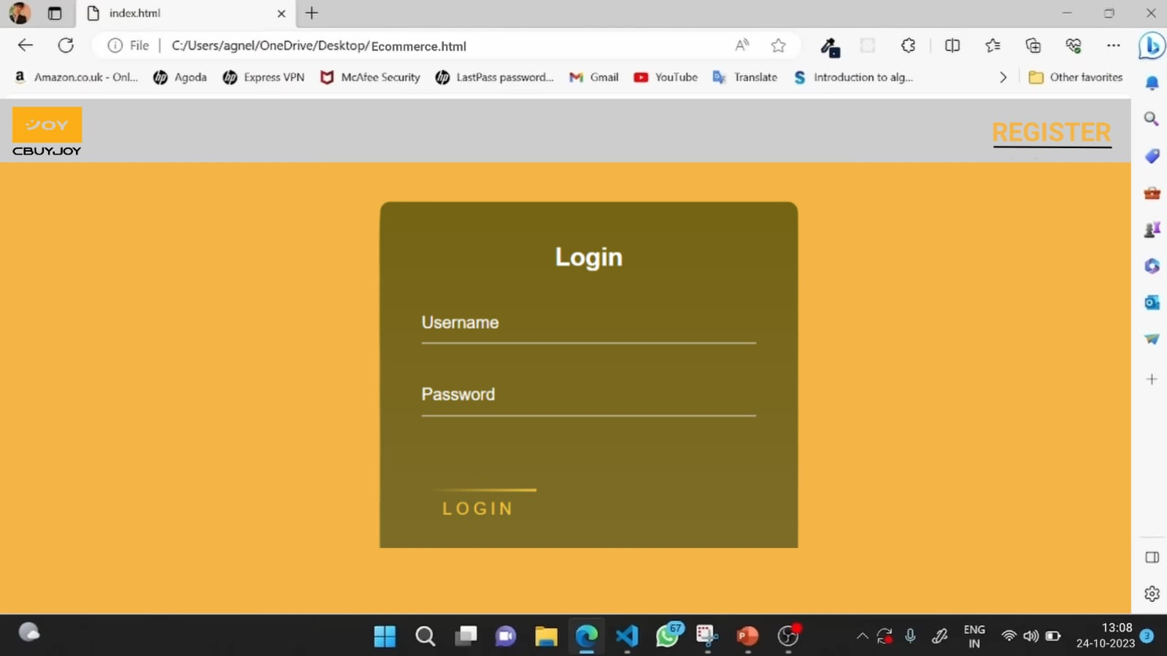
Login form

Slide 4
REGISTRATION FROM
Minimalism and Simplicity: Keep the registration form simple. Ask for only essential information initially. Additional details can be collected after the user is registered and engaged with your platform.
Clear Instructions: Provide clear and concise instructions to guide users through the registration process. Explain why certain information is required and how it will be used.
Required Fields: Clearly indicate which fields are mandatory. Typically, this includes email address or username and password. Avoid asking for excessive information during the initial registration.
Validation: Implement client-side and server-side validation to ensure that the data entered is correct and properly formatted. Provide meaningful error messages to guide users in case of mistakes.

Slide 5
HOME PAGE
The home page in my application/web has contains product catagory and add products and also has add to cart call to action button.
Choose category to goto the next page of the web that has consist of that product category all products with details.
Choose the product and see the product after the customer can decide buy or not.
The user could decide to buy the product or the has like the product there two options for user .
One is “buy now” option and then another one is “add to cart” option.

Slide 6
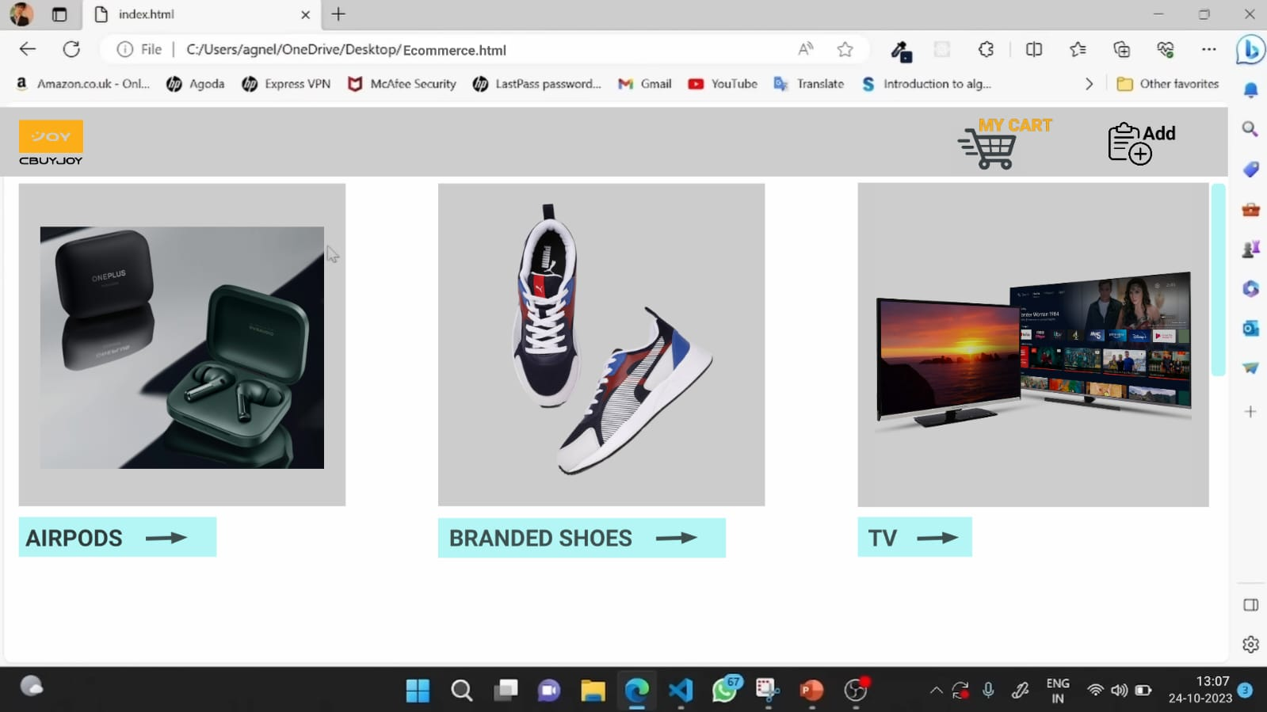
.
.

Slide 7
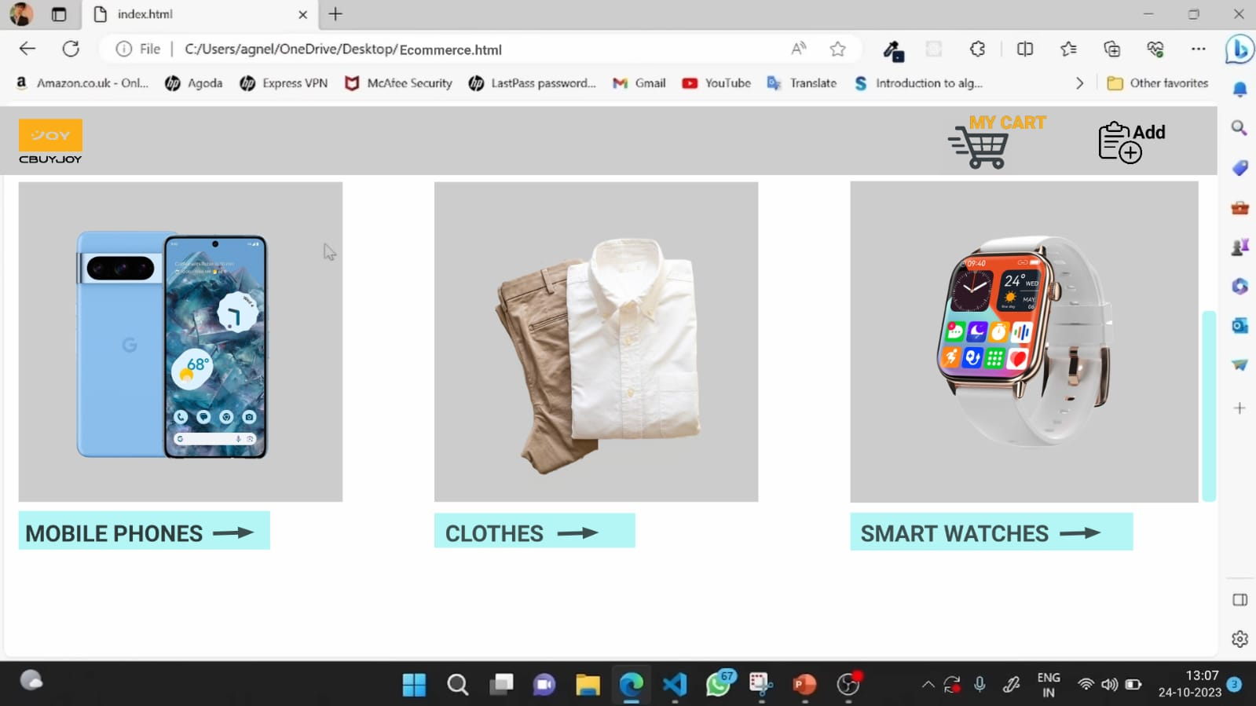
HOME PAGE WITH CALL TO ACTION BUTTONS
The user could decide to buy the product or the has like the product there two options for user .
One is “buy now” option and then another one is “add to cart” option.

Slide 8
CALL TO ACTION BUTTON
Add to Cart" and "Buy Now" are two common options that allow users to make purchases, but they serve different purposes.
experience by providing flexibility based on the customer's preferences and shopping behavior.
"Add to Cart" is more suitable for users who want to browse and compare items before making a final decision, while "Buy Now" caters to users who are ready for an immediate purchase.

Slide 9
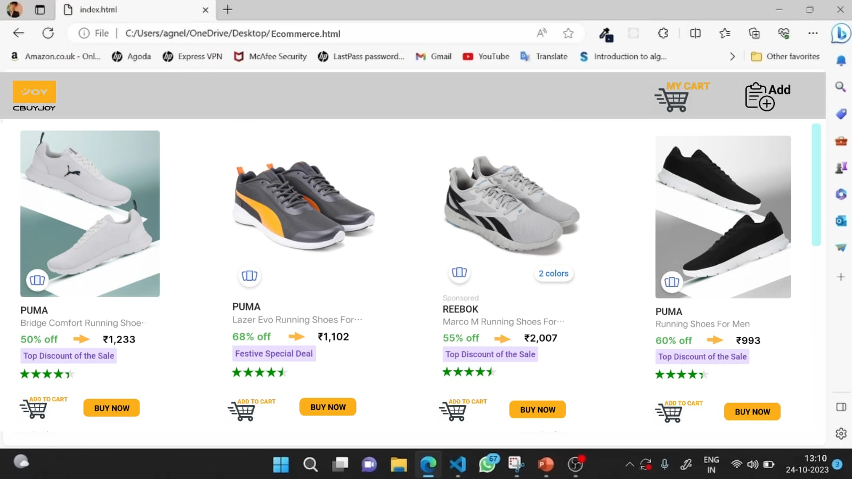
.
Functionality:When a user finds a product they want to buy, they can click the "Add to Cart" button associated with that product.

Slide 10
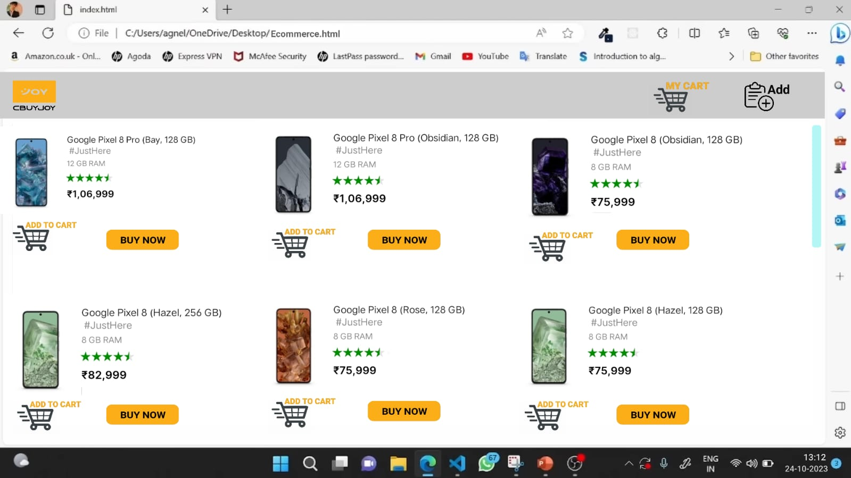
.
Browsing and Selection:Users can continue browsing the website and add more items to the cart as they shop.It allows users to explore the store, compare products, and make selections without immediately committing to a purchase.

Slide 11
ADD TO CART
Add to Cart : When a user clicks on "Add to Cart," the selected item is placed in a virtual shopping cart.
Users can continue browsing the website and add more items to the cart.
It enables users to review their selected items, modify quantities, and remove items before making a final decision to purchase.
This option is convenient for customers who want to shop for multiple items before checking out.

Slide 12
BUY NOW
Buy Now: "Buy Now" is a direct purchase option . When a user clicks on "Buy Now," the selected item is immediately taken to the checkout page.
Users skip the step of adding the item to the cart and proceed directly to payment and shipping details.
This option is ideal for customers who want to make a quick purchase without the need to review or add more items to the cart.

Slide 13
CART TOTAL CALCULATION
The how many no of products are added to cart the sum of the cart products value is total cart calculation.
On clicking the “Add to cart” button on the product tile, this function is invoked. It reads the product details from the product grid where the clicked “Add to cart” is placed.
Create a function that takes the item to be added as a parameter.
Retrieve the current cart data from local storage.Check if the item to be added already exists in the cart.
If so, increase its quantity. If not, add the item to the cart with a quantity of 1.Save the updated cart data to local storage.

Slide 14
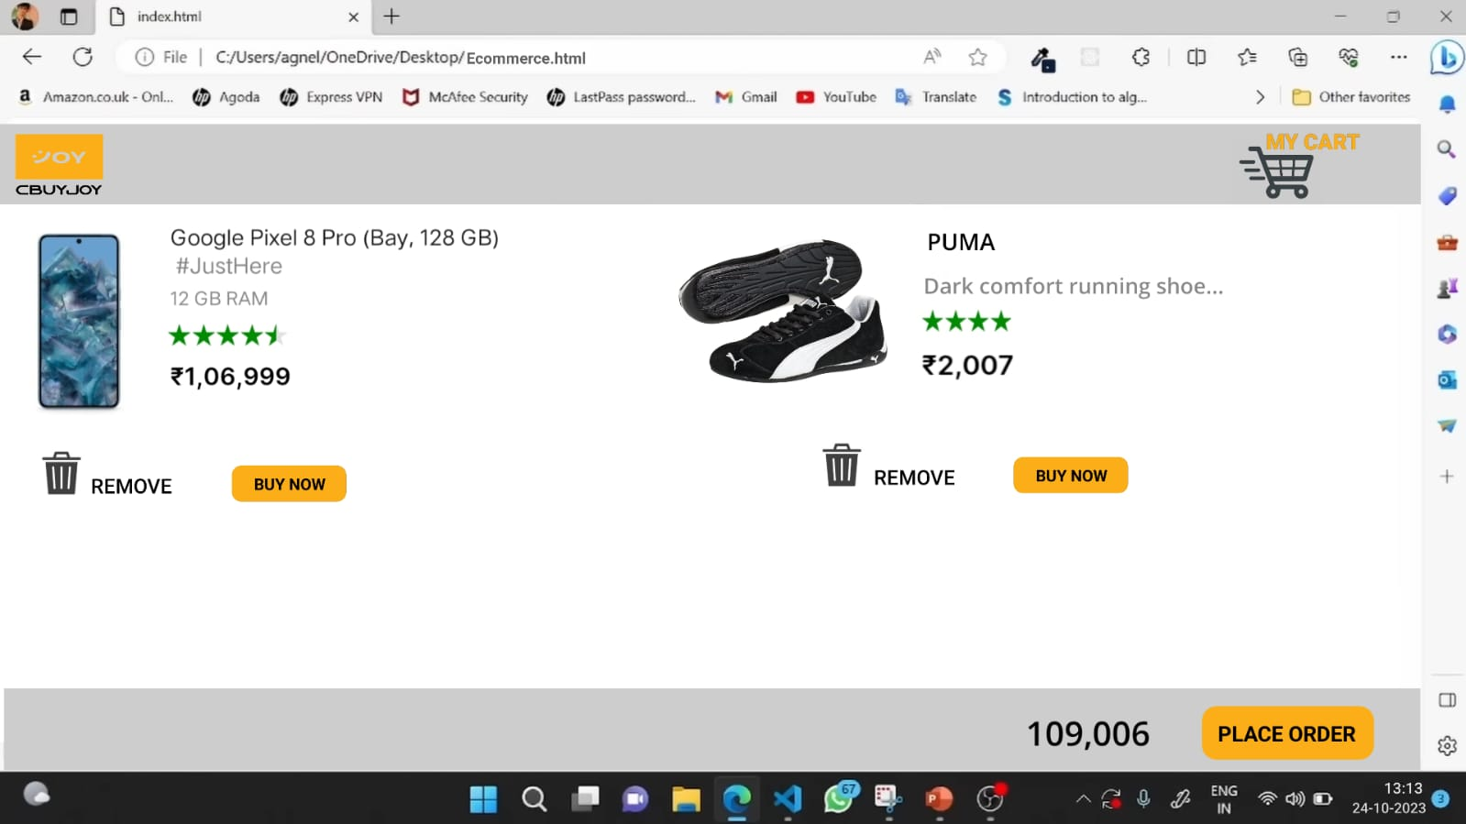
.
Update the UI to reflect the changes in the cart.

